Slide 1
Human activity recognition
BY: Rishu Raj Sinha (20cs3051)

Slide 2
Table of content
What problem we are trying to solve?
Requirements.
Dataset details.
Model selection and details.
How to implement?
Results
Conclusion

Slide 3
What problem we are trying to solve?
In recent years, automatic human activity detection has attracted much attention in the field of video analysis technology due to the growing demand in many applications such as surveillance environments, entertainment environments, and healthcare systems. In a surveillance environment, it can detect dangerous activity. Similarly, in the entertainment environment, activity detection can enhance human-computer interaction, such as automatically recognize the actions of different players in a tennis match.
Imagine, how better it would be if some people started fighting and CCTV recognizes through the movement of their body and inform the surrounding by the mean of any sound system? This can also be possible through human activity recognition model.

Slide 4
How can we solve?
Requirements:
It requires a huge sample of dataset to train the machine.
Selection of appropriate deep learning model which can detect more accurately.
Proper implementation.
Dataset - Link.

Slide 5
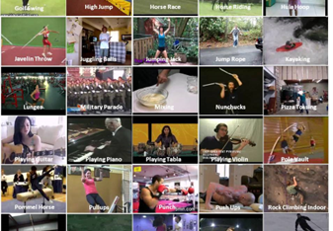
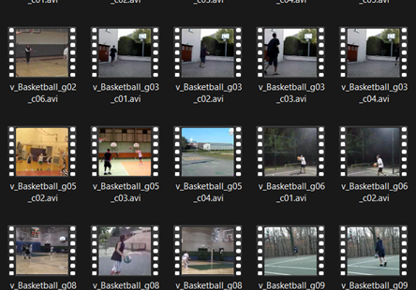
Dataset details
Screenshots of dataset folder

Slide 6
We are using the UCF50 – Action Recognition Dataset, consisting of realistic videos.
The Dataset contains:
50 Action Categories
25 Groups of Videos per Action Category
133 Average Videos per Action Category
199 Average Number of Frames per Video
320 Average Frames Width per Video
240 Average Frames Height per Video
26 Average Frames Per Seconds per Video

Slide 7
Model selection & details
We are using ConvLSTM(CNN +LSTM) model.
Why?
Convolutional Neural Networks (CNN) are great for image data and Long-Short Term Memory (LSTM) networks are great when working with sequence data but when we combine both of them, we get the best of both worlds and we solve difficult computer vision problems like video classification..

Slide 8
Convolutional Neural Network(CNN)
A Convolutional Neural Network (CNN or ConvNet) is a type of deep neural network that is specifically designed to work with image data and excels when it comes to analyzing the images and making predictions on them.
It works with kernels (called filters) that go over the image and generates feature maps (that represent whether a certain feature is present at a location in the image or not) and initially it generates few feature maps and as we go deeper in the network the number of feature maps is increased and the size of maps is decreased using pooling operations without losing critical information.

Slide 9
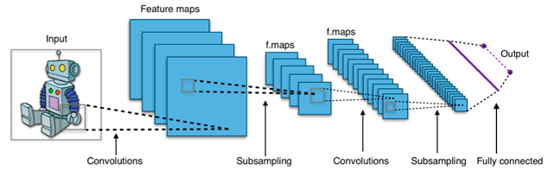
Each layer of a ConvNet learns features of increasing complexity which means, for example, the first layer may learn to detect edges and corners, while the last layer may learn to recognize humans in different postures.

Slide 10
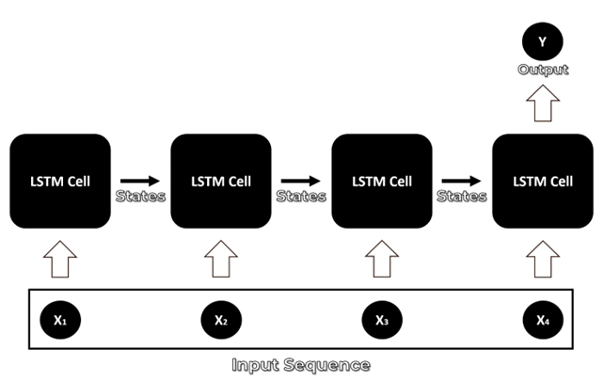
Long Short Term Memory (LSTM)
An LSTM network is specifically designed to work with a data sequence as it takes into consideration all of the previous inputs while generating an output. LSTMs are actually a type of neural network called Recurrent neural network, but RNNs are not known to be effective for dealing with the Long term dependencies in the input sequence because of a problem called the Vanishing gradient problem . LSTMs were developed to overcome the vanishing gradient and so an LSTM cell can remember context for long input sequences.

Slide 11
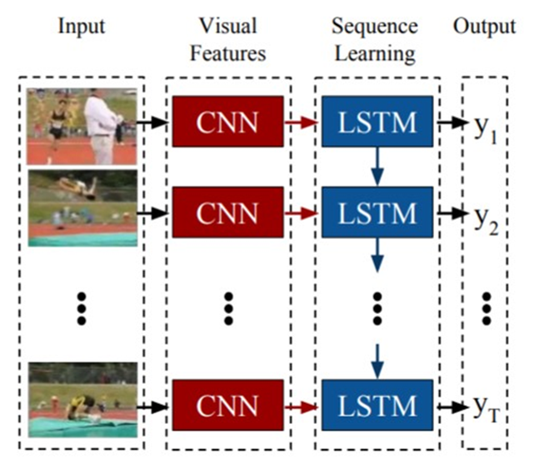
CNN + LSTM approach
By using this approach we can implement both work in single model, We will be using a CNN to extract spatial features at a given time step in the input sequence (video) and then an LSTM to identify temporal relations between frames.

Slide 12
How to implement?
Step 1: Visualise the data with its labels.
Step 2: Pre-process the Dataset
Step 3: Split the data into train and test set.
Step 4: Implement the ConvLSTM approach.
Step 4.1: Construct the model.
Step 4.2: Compile & Train the model.

Slide 13
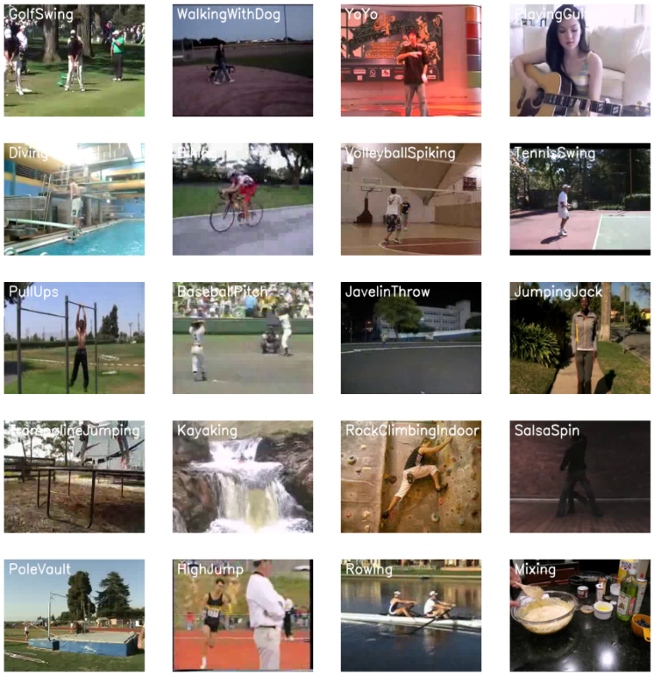
Step 1: Visualise the data with its labels.
For visualization, we have picked 20 random categories from the dataset and a random video from each selected category and will visualize the first frame of the selected videos with their associated labels written.

Slide 14
Step 2: Pre-process the Dataset
Next, we have performed some preprocessing on the dataset. First, we read the video files from the dataset and resize the frames of the videos to a fixed width and height, to reduce the computations and normalized the data to range [0-1] by dividing the pixel values with 255, which makes convergence faster while training the network.
Created a Function to Extract, Resize & Normalize Frames
Created a Function for Dataset Creation

Slide 15
Step 3: Split the data into train and test set.
After data processing ,now we have:
1)A NumPy array containing all the extracted frames of the videos)
2)a Numpy array containing all class labels in one hot encoded format.
So now, we can split our data to create training and testing sets. We have also shuffled the dataset before the split to avoid any bias and get splits repsenting the overall distribution of the data

Slide 16
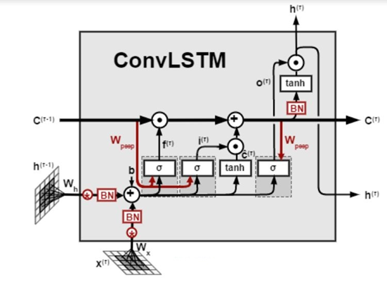
Step 4: Implement the ConvLSTM approach.
In this step, we have implemented the first approach by using a combination of ConvLSTM cells. A ConvLSTM cell is a variant of an LSTM network that contains convolutions operations in the network. it is an LSTM with convolution embedded in the architecture, which makes it capable of identifying spatial features of the data while keeping into account the temporal relation.

Slide 17
Step 4.1: Construct the model.
We have used Keras ConvLSTM2D recurrent layers to build the model. The amount of filters and kernel size required for applying the convolutional operations are also taken into account by the ConvLSTM2D layer The output of the layers is flattened in the end and is fed to the Dense layer with softmax activation which outputs the probability of each action category.
We have also used MaxPooling3D layers to reduce the dimensions of the frames and avoid unnecessary computations and Dropout layers to prevent overfitting the model on the data.

Slide 18
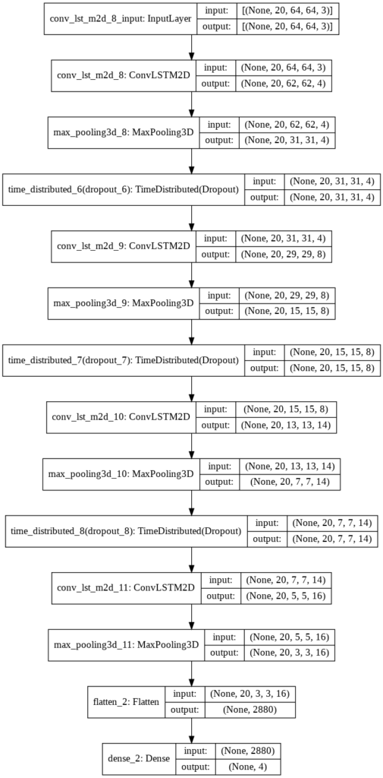

Model 's structure

Slide 19
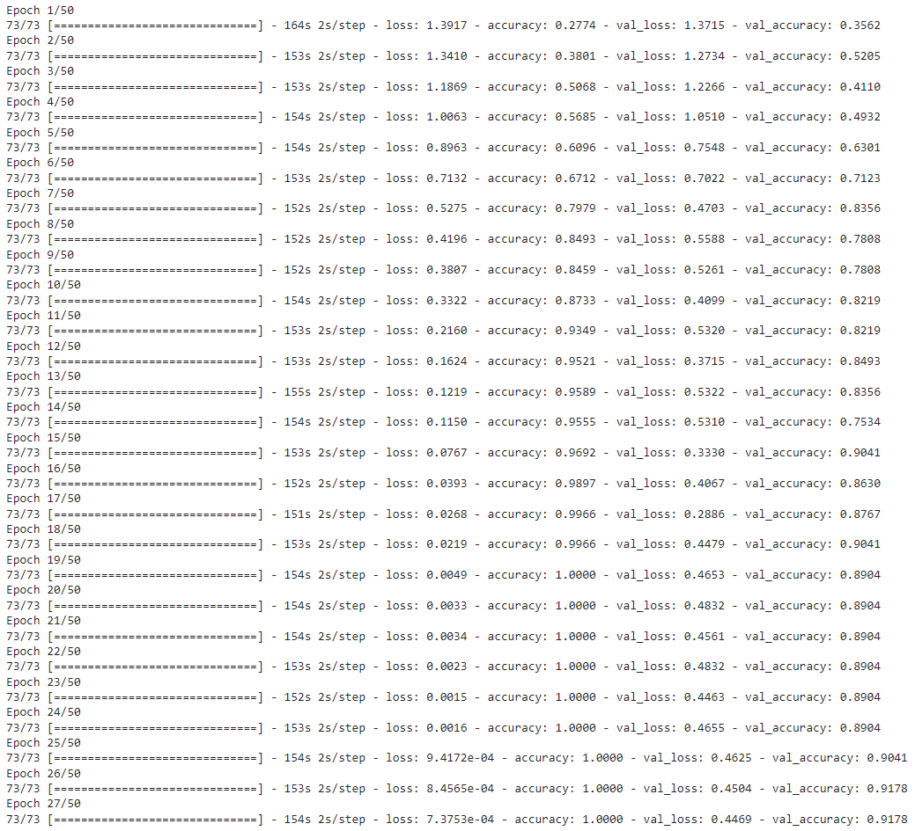
Step 4.2: Compile & Train the model.
We have added an early stopping callback to prevent overfitting and start the training after compiling the model.
Output of compilation

Slide 20
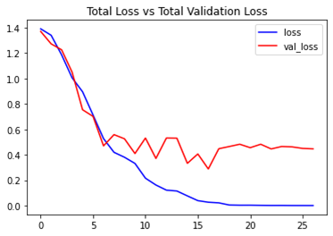
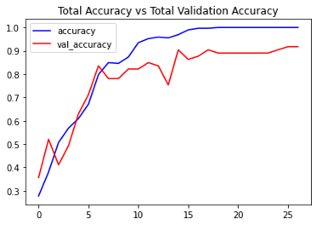
Results:

Slide 21
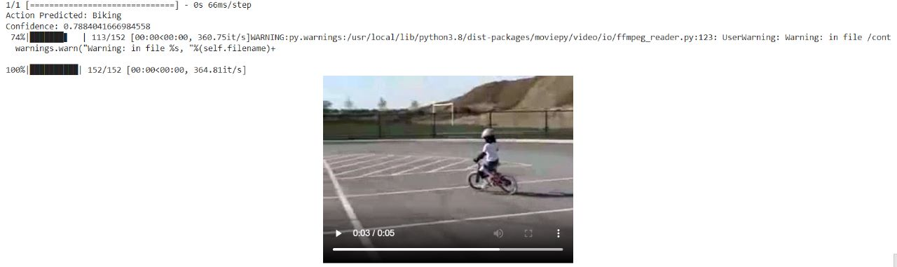
Result for test on a sample video:(output => Action predicted: Biking)

Slide 22
Conclusion
The prime purpose of this project is to design a simple yet effective deep learning architecture which can effectively extract salient discriminative features from limited training data. The experimental outcomes indicates that the proposed model successfully extracted salient features from the sample data and classified activities with considerable accuracy. Although we can improve the accuracy by training a wide variety of data samples but it requires much more resources in terms of processing unit.

